Slide 1

NETWORK SECURITY CRYPTOGRAPHY
By Shreyansh Jain

Slide 2
WHAT IS NETWORK A network is an interconnection or a media between two or more systems to share information among them. ∗ The various threats caused to network are : Remote Login, Application Backdoors, SMTP Session Hijackings, Operating System Bugs, Spams ,Viruses etc.
Security used to be an inconvenience sometimes, but now it’s a necessity all the time.

Slide 3
NETWORK SECURITY ?
The security provided to the network is called network security which at present is looming on horizon as a massive problem.
There are two kinds of Network Security mainly as :
▪ Transit Security :
It just encrypts the packets to be transferred.
▪ Traffic Security :
It acts just as a screen between hosts & remote sites.

Slide 4
PROBLEMS & ATTACKS
There are few intertwined areas in network security as:
▪ Secrecy
▪ Authentication
▪ Non-Repudiation
▪ Integrity Control etc.
∗ The threats are classified into two categories :
Passive Attacks :
A passive attack is one in which the attacker eavesdrops and listens to the message but can’t modify the message.
Active Attacks :
An active attack is one in which the attacker modifies, deletes, replay or introduce new messages into the stream of message.

Slide 5
CRYPTOGRAPHY
* Cryptography is the ability to send information between particulars in a way that it prevents others from reading the data.
* The data is transferred by applying two techniques by changing the plain text & Cipher texts as Encryption (P to C) & Decryption (C to P).

Slide 6
PRINCIPLES & SERVICES OF CRYPTOGRAPHY
The two fundamental principles of cryptography are:
▪ Messages must contain some Redundancy (information not needed to understand the message).
▪ Some method is needed to foil replay attacks (validation of messages by timestamp) i.e. freshness.
∗ The services provided by the cryptography are as follows:
▪ Integrity Checking
▪ Authentication
▪ Protection to the data
▪ Confidentiality of information etc.

Slide 7
ENCRYPTION & DECRYPTION
* The way of converting the plain text to the cipher text by the means of few keys is called as “encryption”.
* The way of converting the cipher text to the plain text by the use of keys that are suitable to it is called as “decryption”.

Slide 8
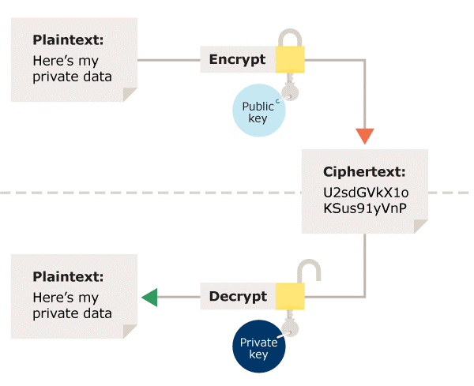

Slide 9
Reference:
* https://www.wikipedia.org/
* https://www.slideshare.net

Slide 10
Thank You
Poor Third-Party Vendor Security Can Lead To Data Breach so securing it is utmost importance.

